Slide 1

Chapter 3
Perception and Communication

Slide 2
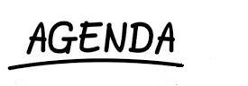
Define Perception
The Perception Process
Selection
Organization
Interpretation
Influences on Perception
Improving Perception

Slide 3
Connect the Dots Puzzle
Notes:
Connect all dots using 4 straight lines.

Slide 4
Connect the dots
Did you stay within the boundaries of the square?
Try it again.
How much of what we perceive is restricted by barriers that may or may not be true?

Slide 5
Perception is the active process of creating meaning by selecting, organizing, and interpreting people, objects, events, situations, and activities

Slide 6
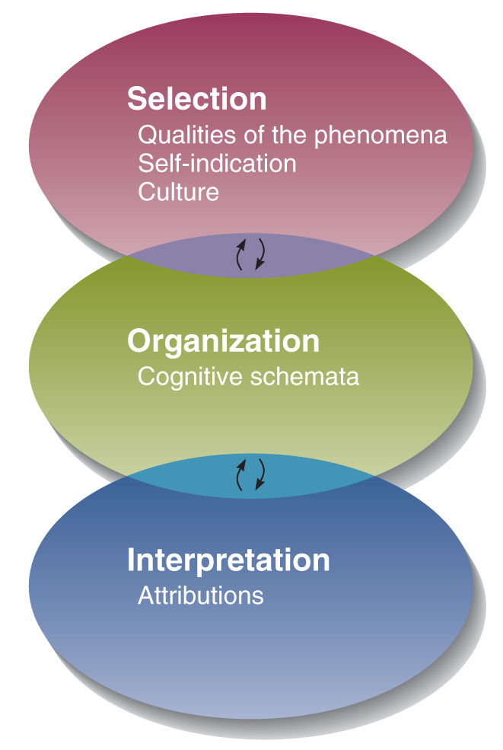
The Process of Human Perception

Slide 7

Selection
What do
you see?

Slide 8
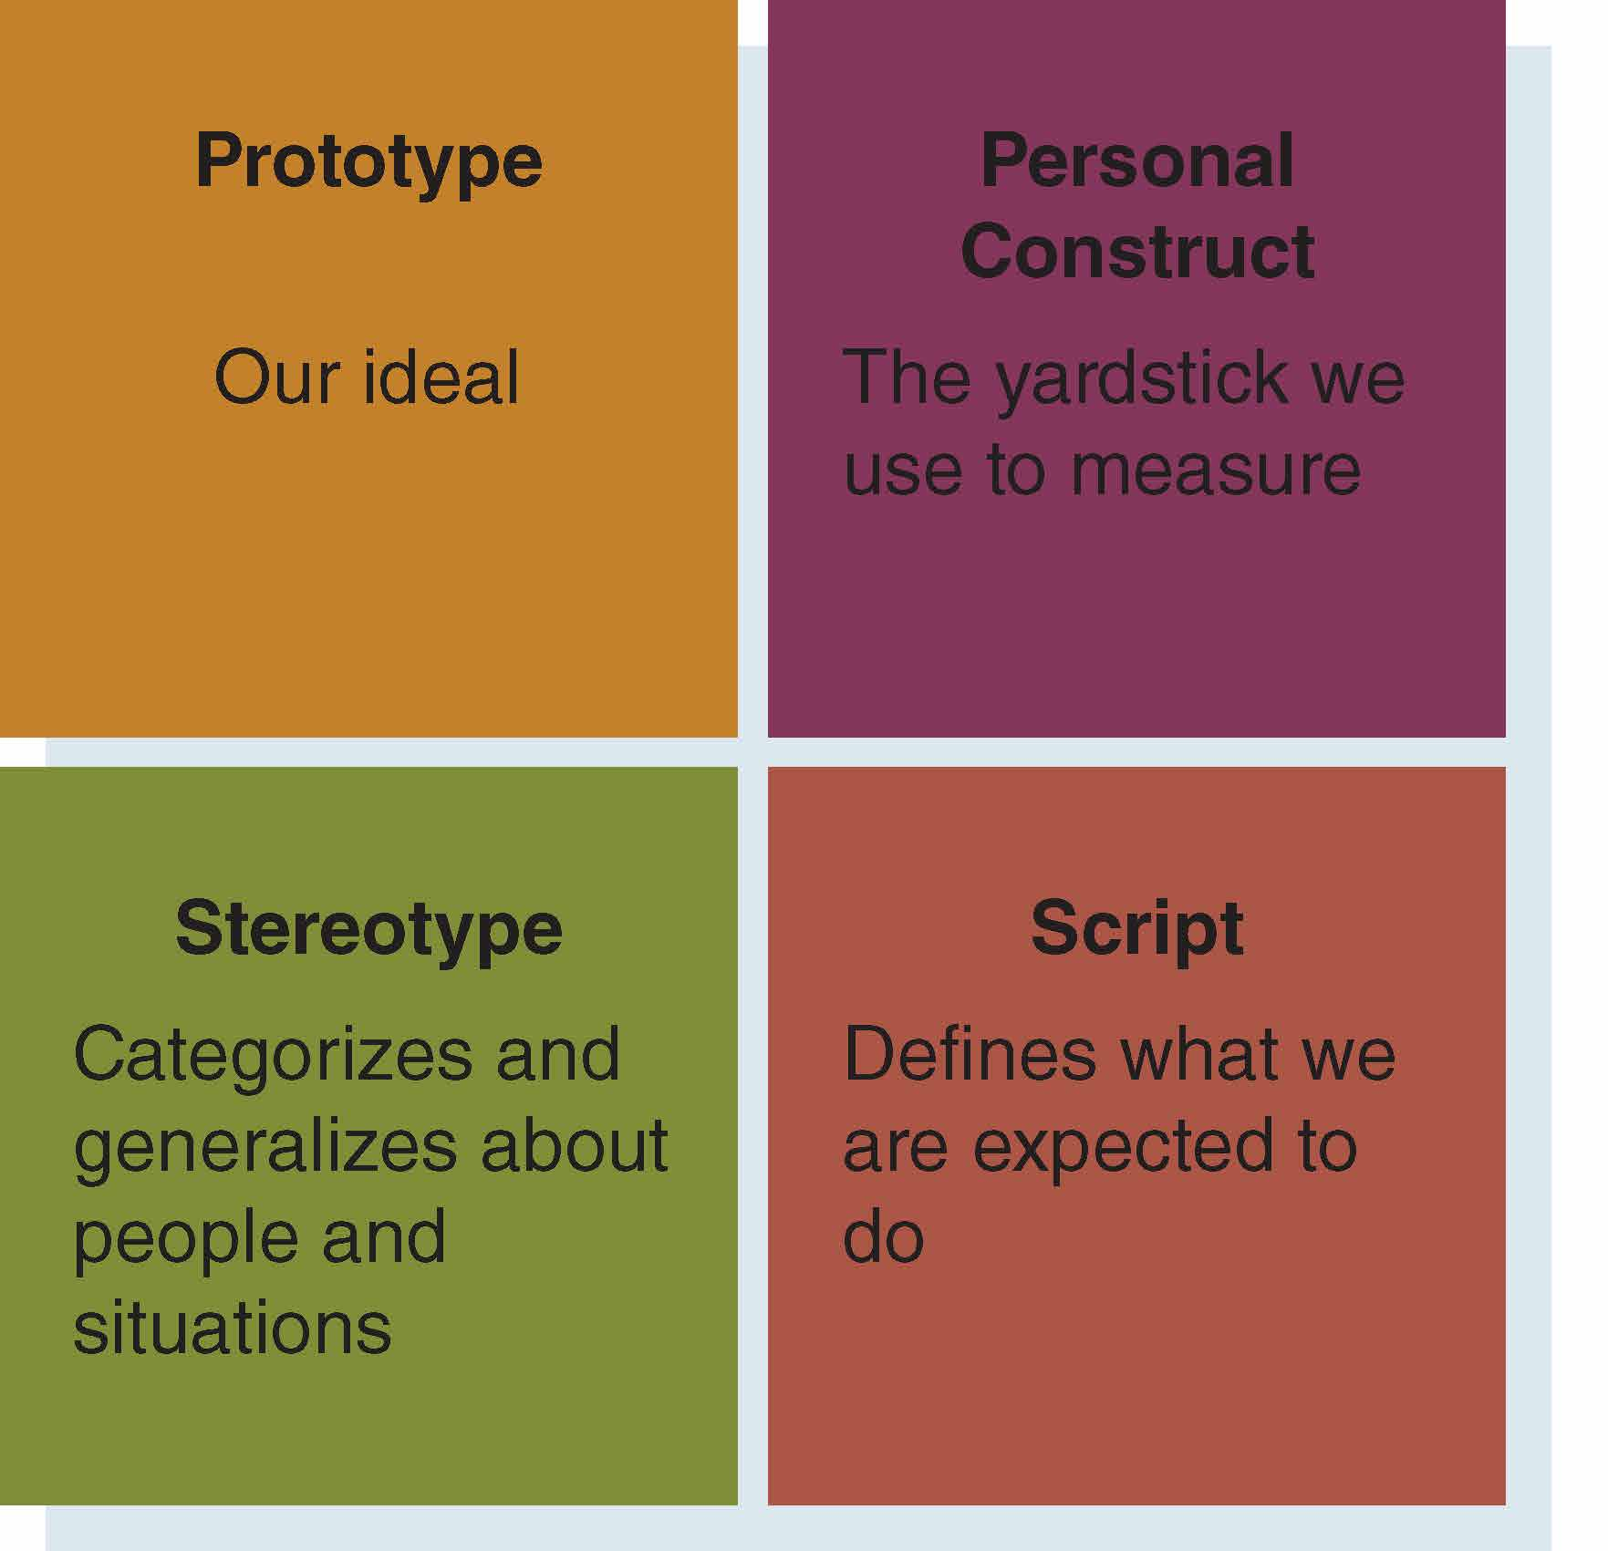
Organization
Four
Cognitive
Schemata

Slide 9
Stereotypes
Predictive generalizations about minority groups based on assumptions that all members are the same

Slide 10
Interpretation - Attribution
Attribution: an explanation for why something happened or why something is a certain way.
External Attribution: cause is outside of the self.
Can you think of an example?
Internal Attribution: cause is the self.
Can you think of an example?
Notes:
External – others, weather, equipment, objects, time, etc.
Internal – personality, personal capability, individual factors

Slide 11
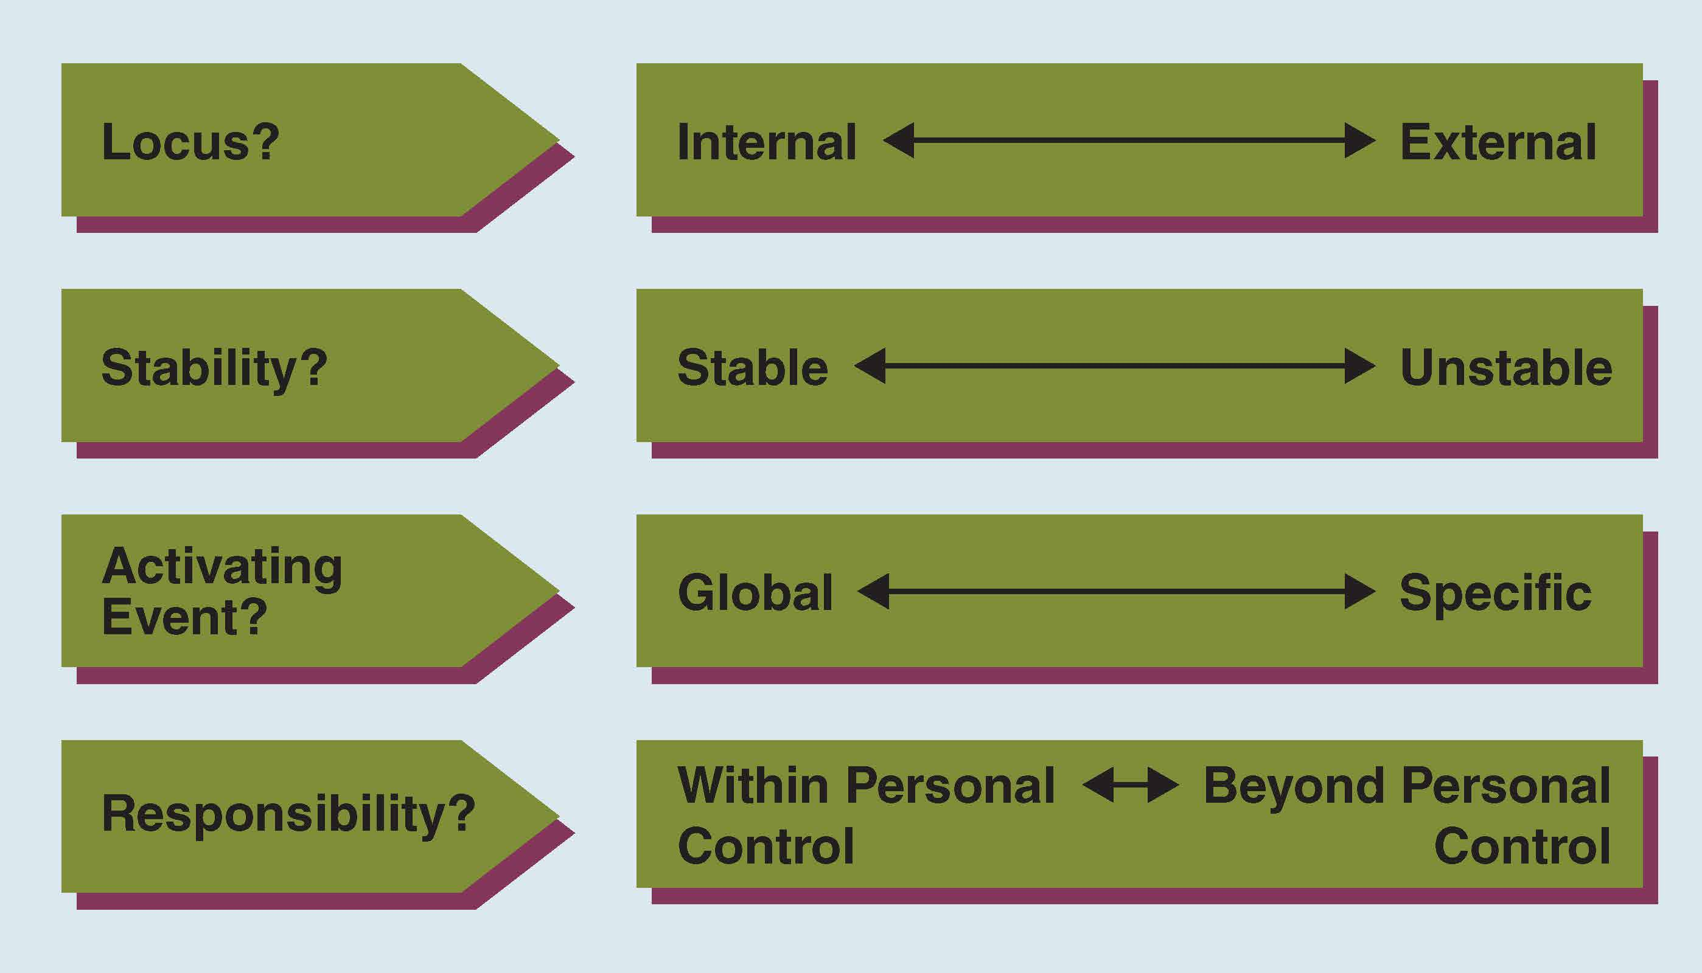
Four Dimensions of Attributions
Interpretation

Slide 12
Attribution Errors
Self-serving Bias
Fundamental Attribution Error

Slide 13
Self-Serving Bias
We tend to see ourselves in a positive light.
We tend to minimize or ignore negative information about the self.
We overestimate positive outcomes and underestimate negative outcomes.
Notes:
External – others, weather, equipment, objects, time, etc.
Internal – personality, personal capability, individual factors

Slide 14
Fundamental Attribution Error
Tested in many cultures, situations, and across various people.
Internal/External Attribution?
Positive Outcome (100% on exam)
Self =
Others =
Negative Outcome (failed test)
Self =
Others =
Notes:
External – others, weather, equipment, objects, time, etc.
Internal – personality, personal capability, individual factors

Slide 15
Influences on Perception
Physiology
Age
Culture (Standpoint)
Roles
Cognitive Abilities (Cognitive Complexity, Person-Centredness)
Self

Slide 16
Guidelines for Improving Perception and Communication
Recognize That All Perceptions Are Partial and Subjective
Avoid Mind-Reading
Check Perceptions with Others
Distinguish Between Facts and Inferences
Guard Against the Self-serving Bias
Guard Against the Fundamental Attribution Error
Monitor Labels

Slide 17
Labels, Perception and Influence
Words influence perception
Our perceptions are one step away from reality
Responding to labels not behaviour removes us further
Labelling moves another step from reality

Slide 18
Summary
Definition of Perception
Improving Accuracy
Boundaries and Limitations
Chapter 3
Influences
Perception Process
Self-Serving Bias
Attribution

